Slide 1
UCIe TX System-Level Behavioral Model (32 GT/s)
By project guide
Mamatha Bandari Vivek Chaturvedi
152502013
M. Tech (SOCD)

Slide 2
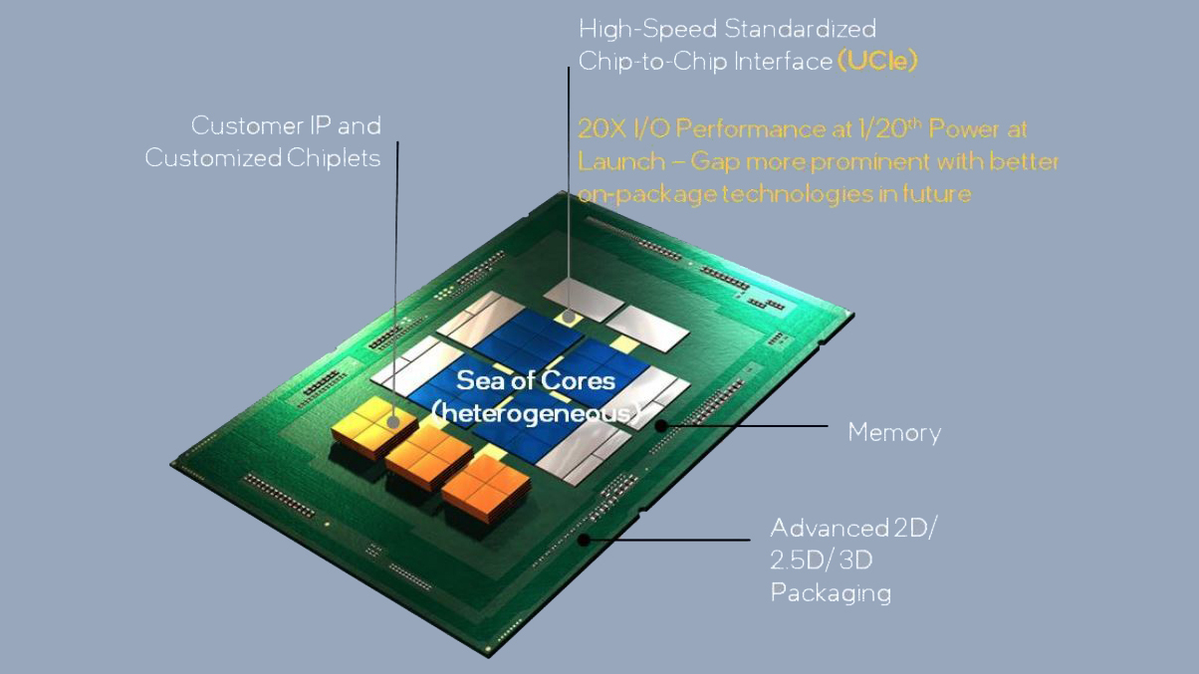
Why UCIe & Project Proposal
The Chiplet Revolution
Standardization: UCIe is an open standard designed to connect "chiplets" from different vendors inside one package.
Heterogeneous Integration: Mix and match CPU, GPU, and Memory logic seamlessly like LEGO building blocks.
Problem Statement: At 32 GT/s, signals degrade. We need to verify the design behaviorally before spending millions on silicon hardware.
Proposal: A modular MATLAB simulation engine to predict link performance, BER impact accurately.

Slide 3
Objective:
Model Implementation: Develop a standalone MATLAB behavioral model mapping the entire UCIe 2.0 transmitter signal chain.
Impairment Study: Evaluate the impact of TX FFE, finite rise times, and RC parasitics on signal integrity.
Metric Verification: Quantify performance using Q-factor, Eye Height, and Bit Error Rate (BER) across different packaging scenarios.

Slide 4
System Specifications:
Data rate = 32 GT/s
UI = 31.25 ps
Samples/UI = 16
TX swing = 0.625 V
TX rise time = 6.25 ps
TX output = 30 Ω, 0.1 pF
Channel loss = 30 Ω, 0.1 pF, 2 dB @ 16 GHz
RX load = 50 Ω, 0.2 pF

Slide 5
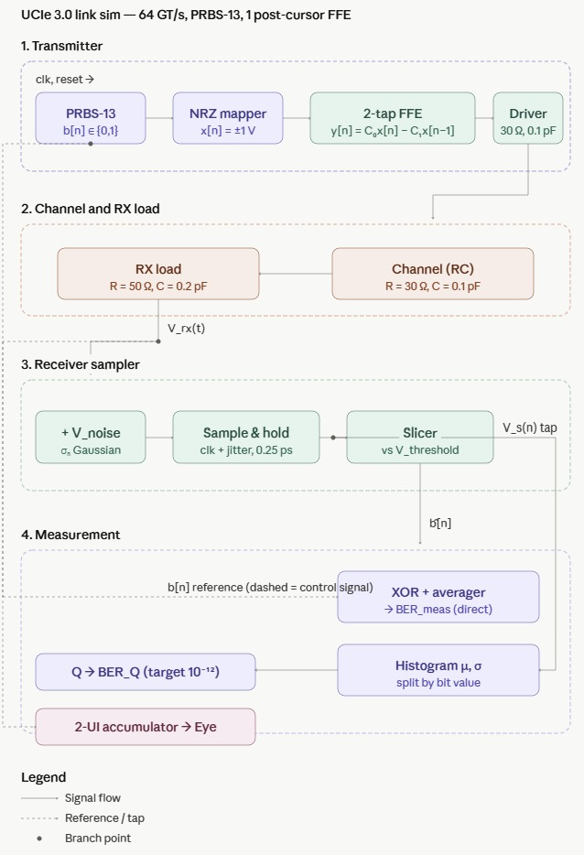
Architecture:

Slide 6
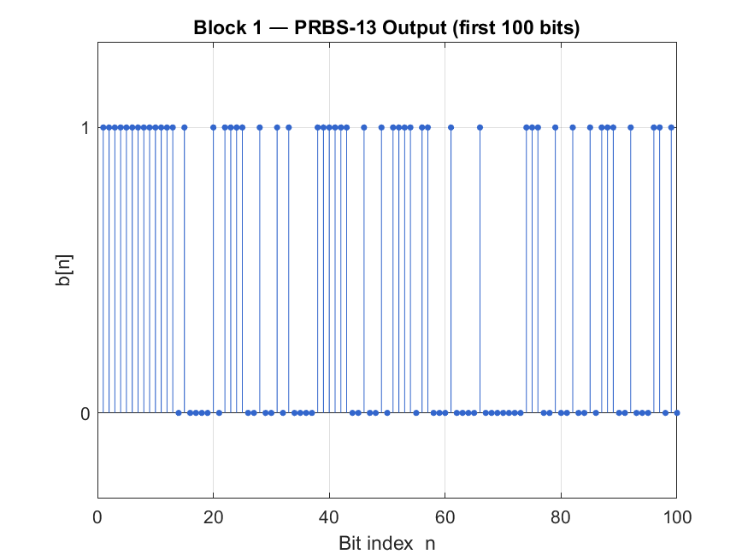
TRANSMITTER MODELING (SECTION 1)
Block 1: PRBS-13 Generator
Generates pseudo-random binary sequence to mimic real data traffic.
Feedback polynomial: P(x) = x^13 +x^4 +x^3 +x+1
Sequence Length ≈ 2^13 -1 =8191 bits.
Output waveform:

Slide 7
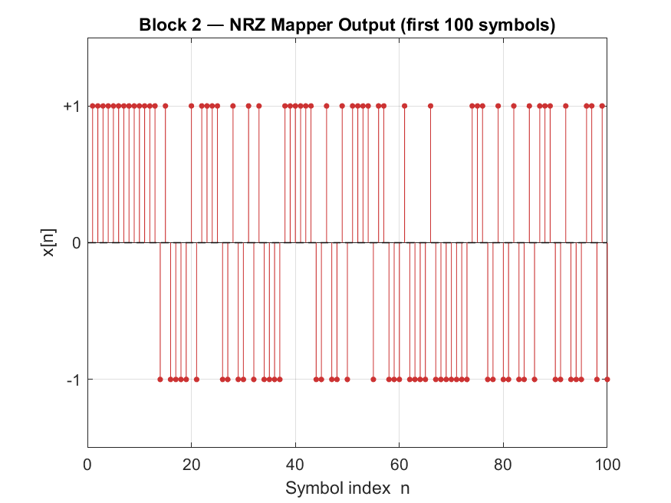
BLOCK 2: NRZ MAPPER
Converts bits into voltage levels.
x[n]=2b[n]−1
Output waveform of NRZ Mapper

Slide 8
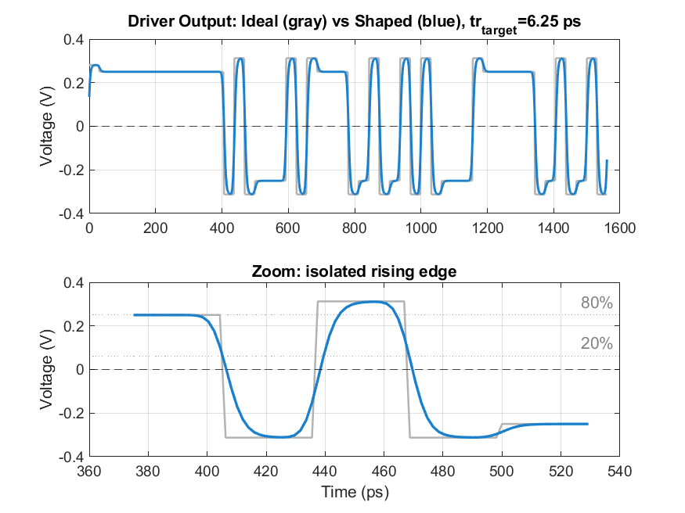
Block 3: TX Driver
Converts symbol stream to analog waveform.
Gaussian shaping models finite rise/fall time.
Output RC models pad resistance and capacitance.
tr = 6.25 ps at 32 GT/s, σs ≈ 3.71 ps.

Slide 9
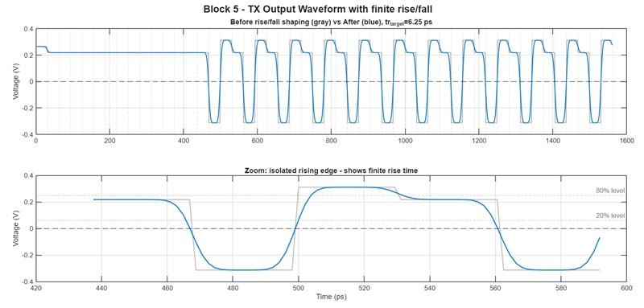
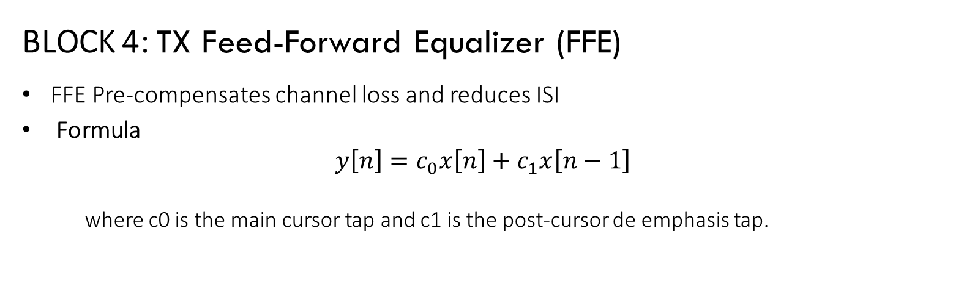
BLOCK 4: TX Feed-Forward Equalizer (FFE)
FFE Pre-compensates channel loss and reduces ISI
Formula
$$y\left[n\right]=c_{0}x\left[n\right]+c_{1}x\left[n−1\right]$$
where c0 is the main cursor tap and c1 is the post-cursor de emphasis tap.

Slide 10
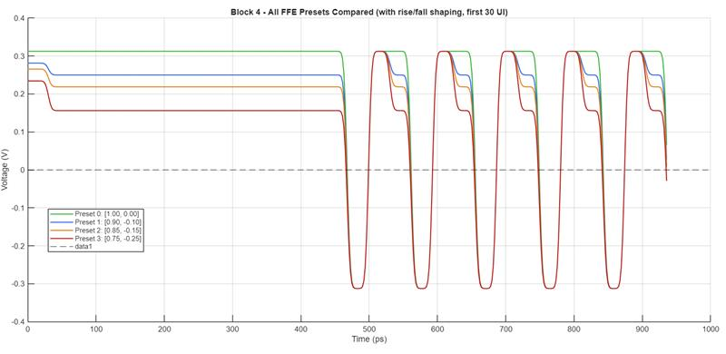
UCIE FFE TAP PRESETS :
Preset | Co | C1 | Description
0 | 1.0 | 0.0 | No equalization
1 | 0.9 | -0.1 | Mild de-emphasis
2 | 0.85 | -0.15 | Moderate de-emphasis
3 | 0.75 | -0.25 | Strong de-emphasis

Slide 11
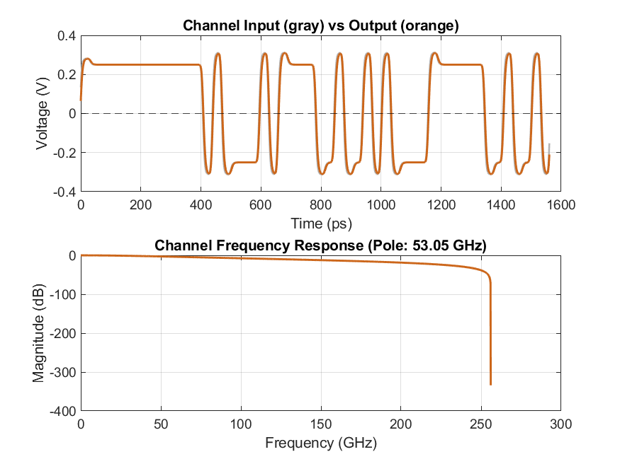
CHANNEL AND RX LOAD MODELING (SECTION 2)
Block 5: Channel RC Model
Resistance + capacitance behave as low-pass filter.
Higher RC causes attenuation and slower edges.
Main source of bandwidth limitation and ISI.
Output waveform

Slide 12
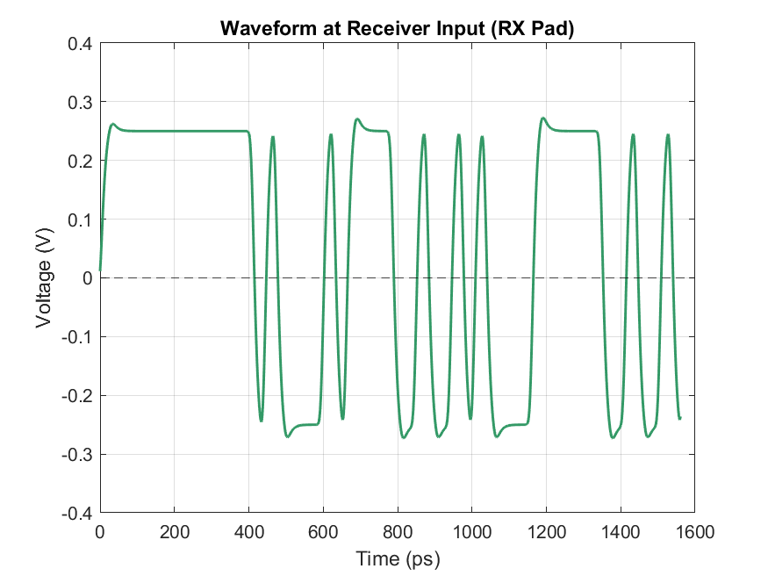
Block 6: RX Termination Load
Receiver input termination = 50Ω.
Pad/input capacitance ≈ 0.2 pF.
Matches line to reduce reflections.
Adds loading that slightly closes eye opening.

Slide 13
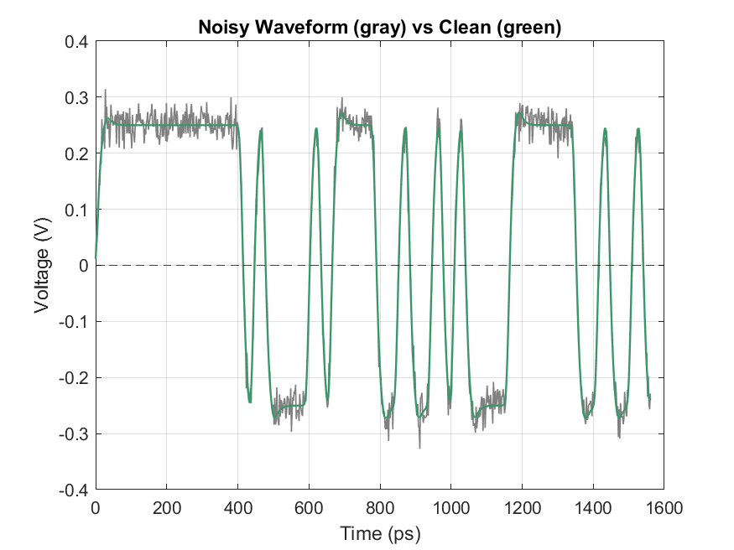
RECEIVER SAMPLER MODELING (SECTION 3)
Block 7: Additive Noise
Adds Gaussian random voltage noise to waveform.
• Models crosstalk from adjacent lanes.
• Models supply ripple and thermal noise.
• Causes vertical eye closure and BER rise.
Output waveform:

Slide 14
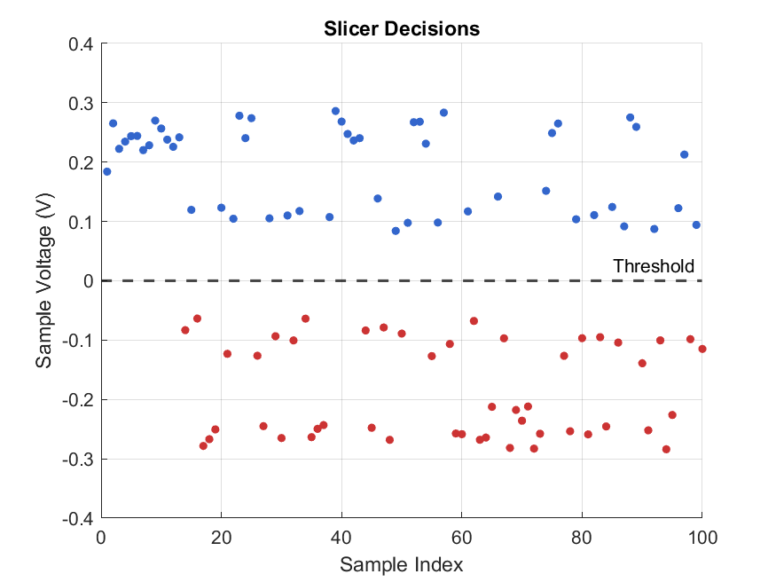
Block 9: Receiver Slicer
Comparator checks sampled value against threshold.
For NRZ threshold is usually 0 V.
Above threshold = bit 1, below = bit 0.
Final digital recovery stage.

Slide 15



MEASUREMENT AND ANALYSIS (SECTION 3)
1. Direct BER Calculation
XOR-based comparator is used which compares transmitted bits vs recovered bits over 10,000 iterations to find the exact Error Rate.
2. Statistical Q-Factor
Used to estimate the "Quality" of the eye when direct errors are rare. It measures how far the '1' and '0' distributions are separated.
where (µ1,σ1) and (µ0,σ0) are the mean and standard deviation of the “1” and “0” voltage distributions, respectively.

Slide 16
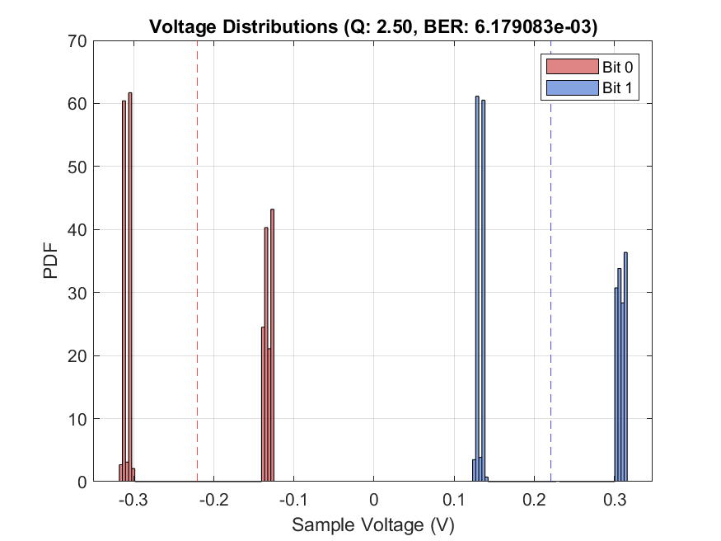
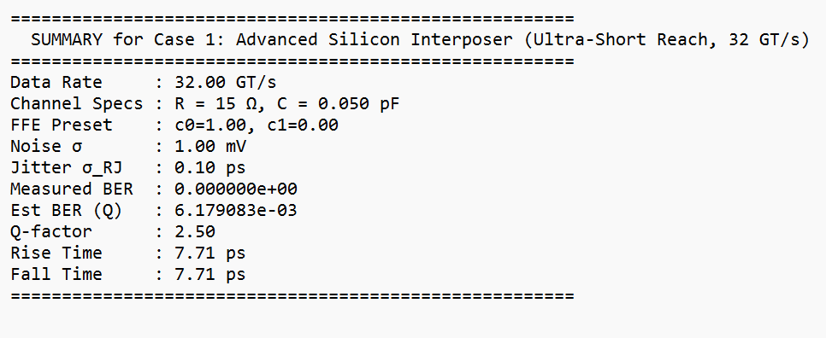
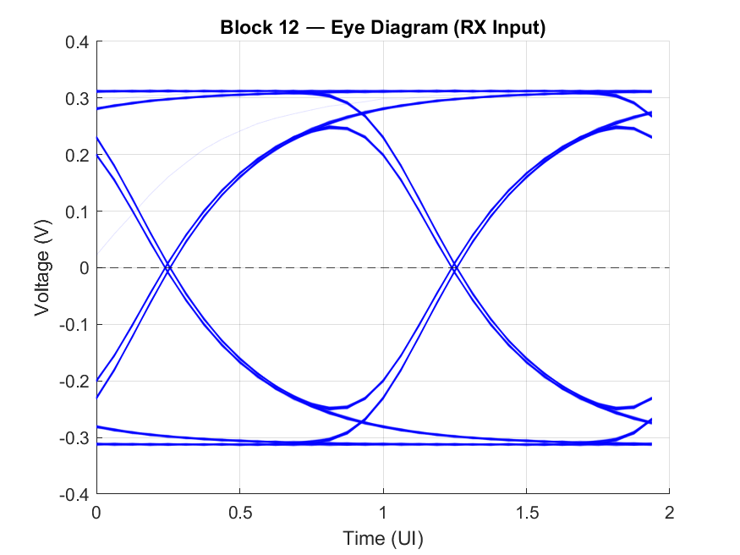
RESULTS AND DISCUSSION:
Measured BER: 0 (no errors in 10,000 bits)
Q-factor: > 2.0 (effectively error-free)
Eye height: ≈ 0.60V (near-ideal)

Slide 17
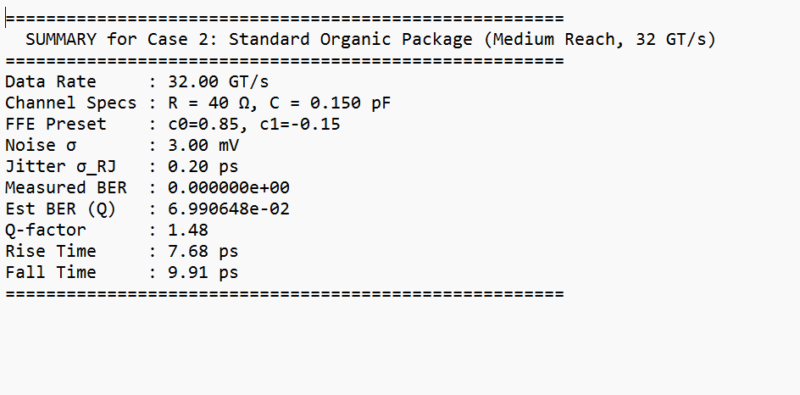
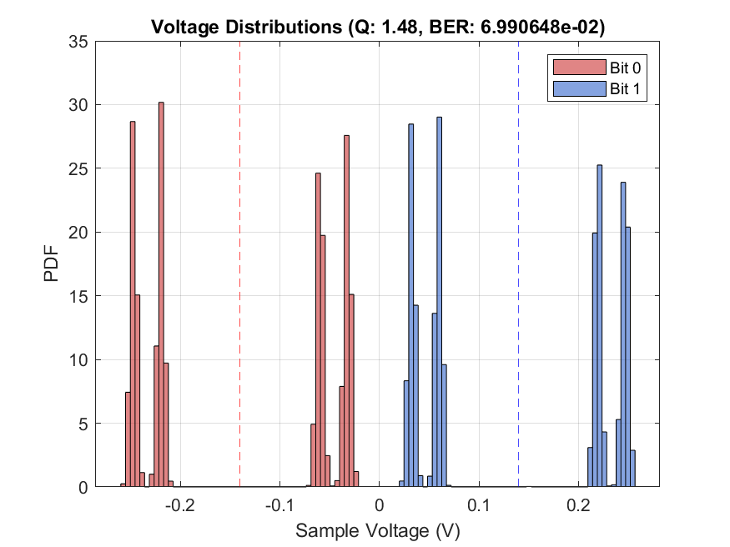
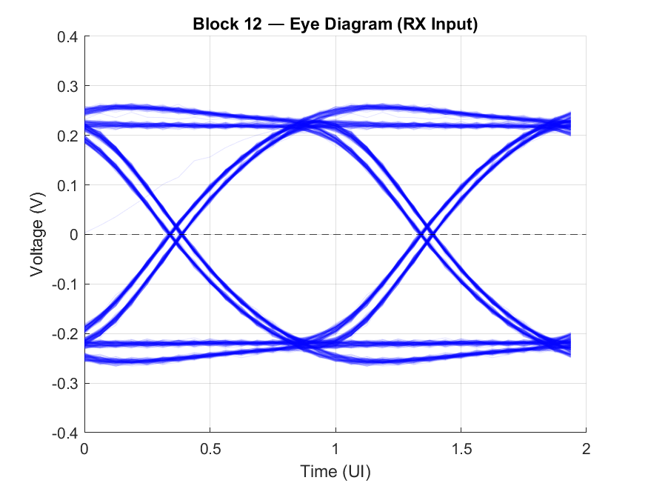
• Measured BER: 0
• Q-factor: ≈ 1.5
• Eye height reduced but sufficient for reliable detection

Slide 18
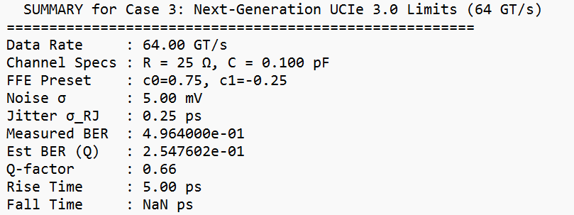
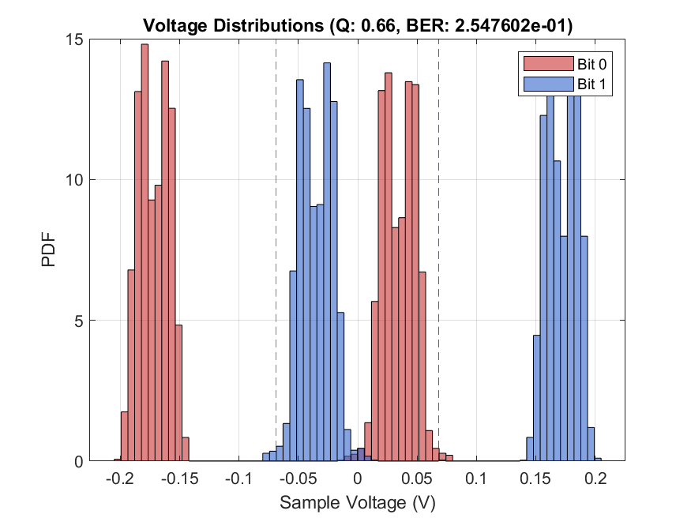
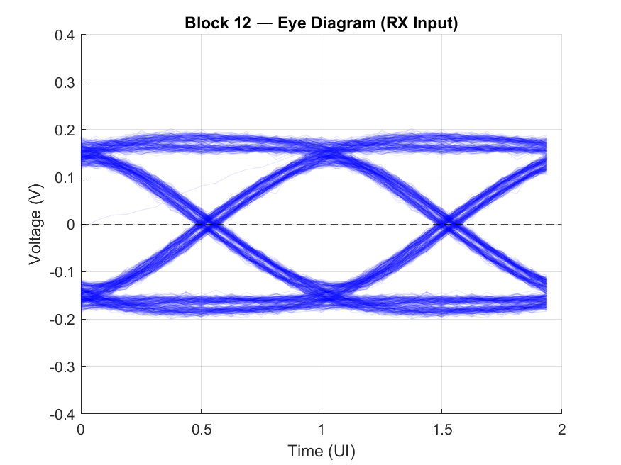
TUI = 15.625ps
The compressed UI significantly reduces timing margins, and even with aggressive de-emphasis, the eye opening is substantially reduced.

Slide 19
Key Observations
The transition from 32GT/s to 64GT/s requires significantly stronger equalization.
Voltage noise causes vertical eye closure, jitter causes horizontal eye closure.
The Q-factor method provides reliable BER estimation even when direct measurement shows zero errors.
FFE de-emphasis is essential for channels with insertion loss > 1dB at Nyquist.

Slide 20
FUTURE SCOPE:
Overcoming Architectural Barriers
My simulation verified that FFE works for 32 GT/s but fails for 64 GT/s. Future extensions must include:
RX Equalization: Continuous-Time Linear Equalizer (CTLE) and Decision Feedback Equalizer (DFE).
S-Parameters: Replace RC models with S-parameter data for accurate reflection modeling.

Slide 21
CONCLUSION
This work presents a complete, modular behavioral model for UCIe 2.0 high-speed serial links.
The key achievements are:
A 12-block architecture that maps one-to-one with the physical signal flow from transmitter silicon through the channel to the receiver decision circuit.
Separate modeling of vertical eye closure (voltage noise) enabling independent analysis of noise.
We verified that while FFE compensates for attenuation, link stability is critically dependent on low jitter

Slide 22
THANK YOU

